Slide 1

1
SMART TOUR GUIDE
AKHNA S J
TVE23MCA-2008
Guide :
Dr. Liji P I
Dept. of Computer Applications
College of Engineering, Trivandrum

Slide 2
2
PROBLEM STATEMENT
The traditional approach to guided tourism, relying on human tour guides, faces limitations in terms of personalization, availability and convenience.
Tourists often struggle to efficiently explore attractions aligned with their specific interests as tour guides mostly follows a fixed route.
Hiring a tour guide can be expensive, especially for private tours.
No existing platform which solely facilitate connections between travelers seeking compatible travel partners.

Slide 3
3
EXISTING SYSTEM
Traditional Tour Guides:
Human guides are commonly used for guided tours.
Limitations:
Availability: Guides have fixed schedules so have to plan our schedule accordingly.
Personalization: Generic recommendations may not suit individual preferences and they might favor some specific spots for personal benefits.
Convenience: Relying on physical guides can be cumbersome.
Expensive: Have to spend money on guides, and thus plays a huge role on budget.

Slide 4
4
PROPOSED SYSTEM
User-Defined Filters:
Users can search for cities and select categories (e.g., adventure activities, historical sites, family-friendly spots, spiritual, beaches, hilltops).
The system processes these filters to provide relevant results.
Based on the filters, the platform displays attractions in the specified city.
Travel Partner Matching:
In addition to attraction recommendations, the app facilitates connections between travelers.
Users seeking travel partners can create profiles and find like-minded individuals and communicate with each other.
Attraction Descriptions:
The platform provides detailed information about attractions, maps and also weather conditions.
Notifications, rating and review systems (including pictures) enhance the overall experience.

Slide 5
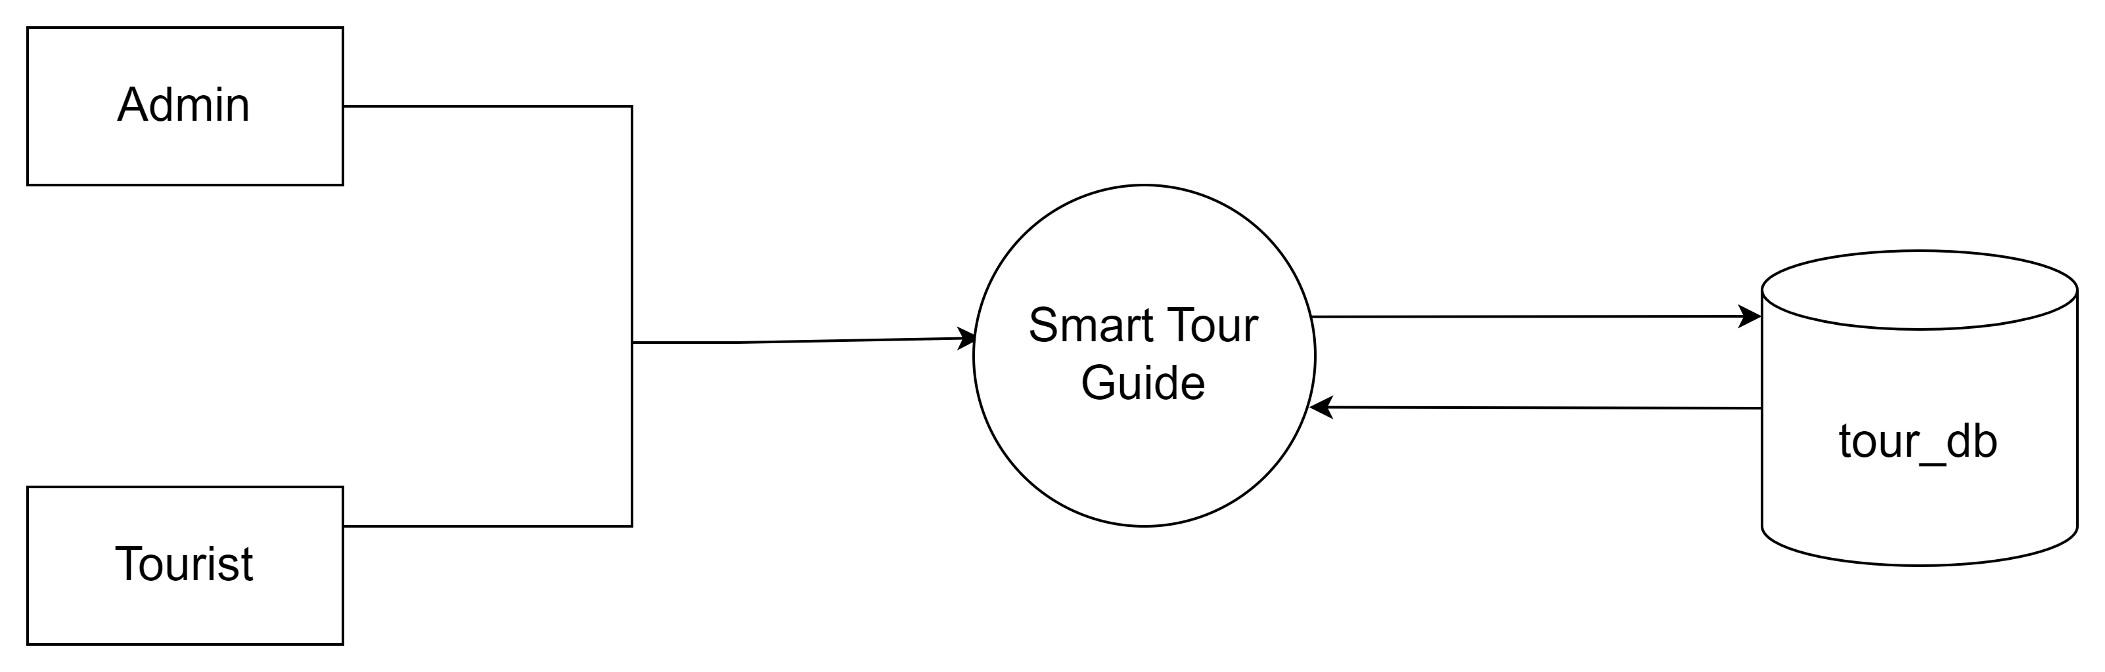
DFD Level 0
5
DESIGN DIAGRAM

Slide 6
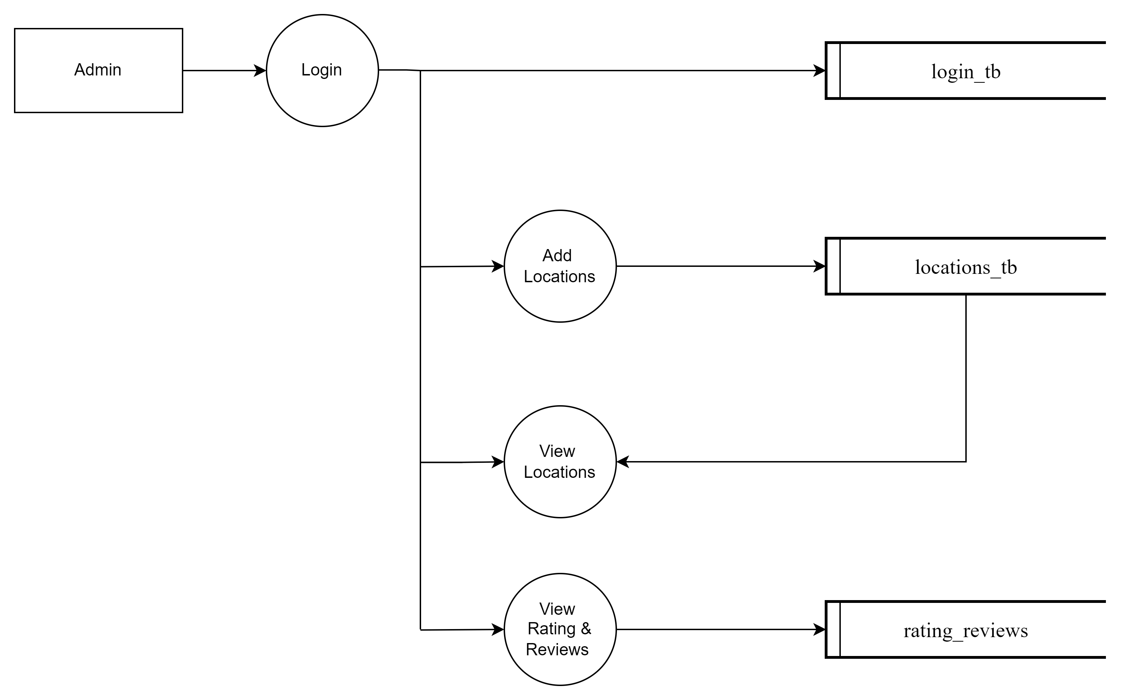
6
DFD Level 1.1

Slide 7
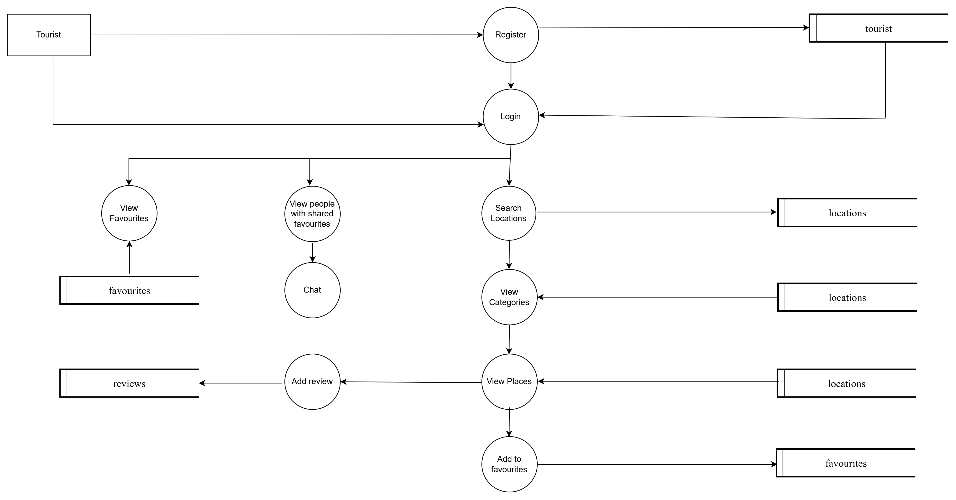
7
DFD Level 1.2

Slide 8
TABLE DESIGN
8
Table Name: tourist_tb
FIELD | CONSTRAINT
t_id | Primary Key
fname
lname
mail_id
phone
gender
age
password
prof_pict

Slide 9
9
Table Name: locations_tb
FIELD | CONSTRAINT
l_id | Primary Key
state
category
location
city
type

Slide 10
10
Table Name: favourites
Table Name: rating_reviews
FIELD | CONSTRAINT
f_id | Primary Key
t_id
l_id
FIELD | CONSTRAINT
r_id | Primary Key
t_id
l_id
rating
review

Slide 11
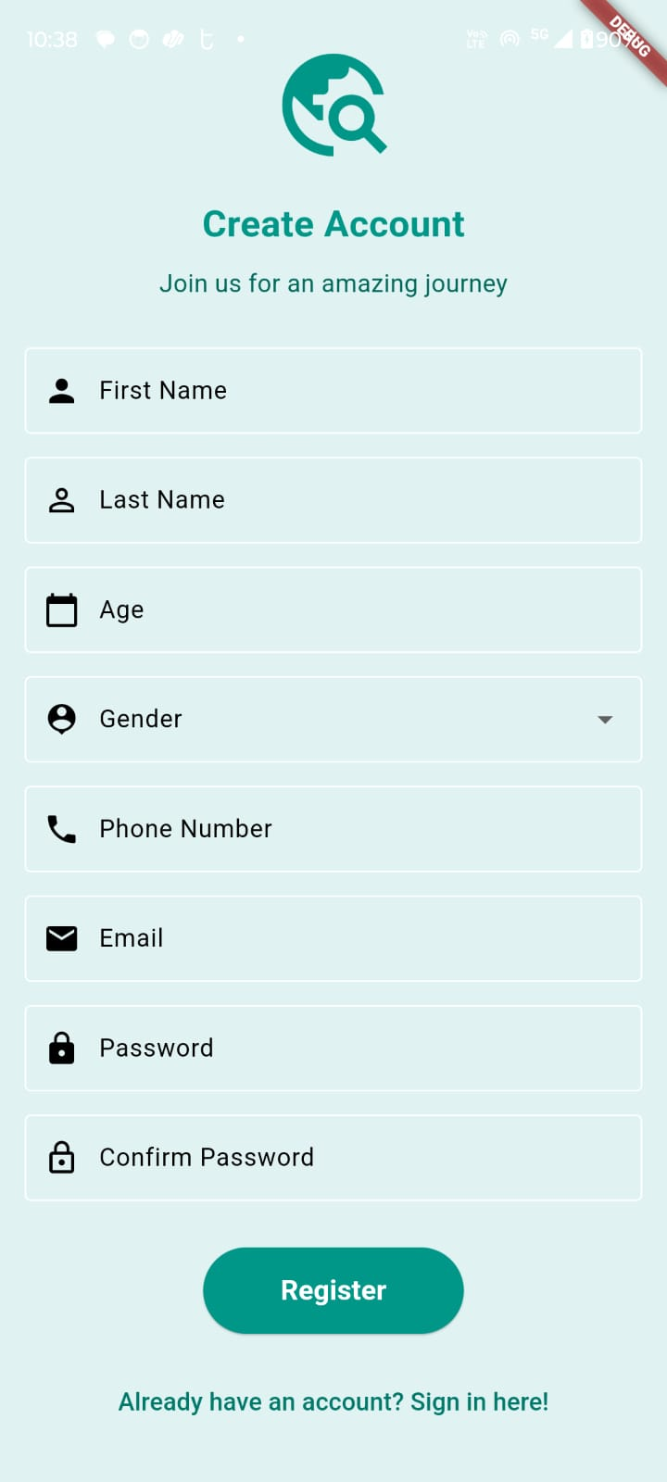
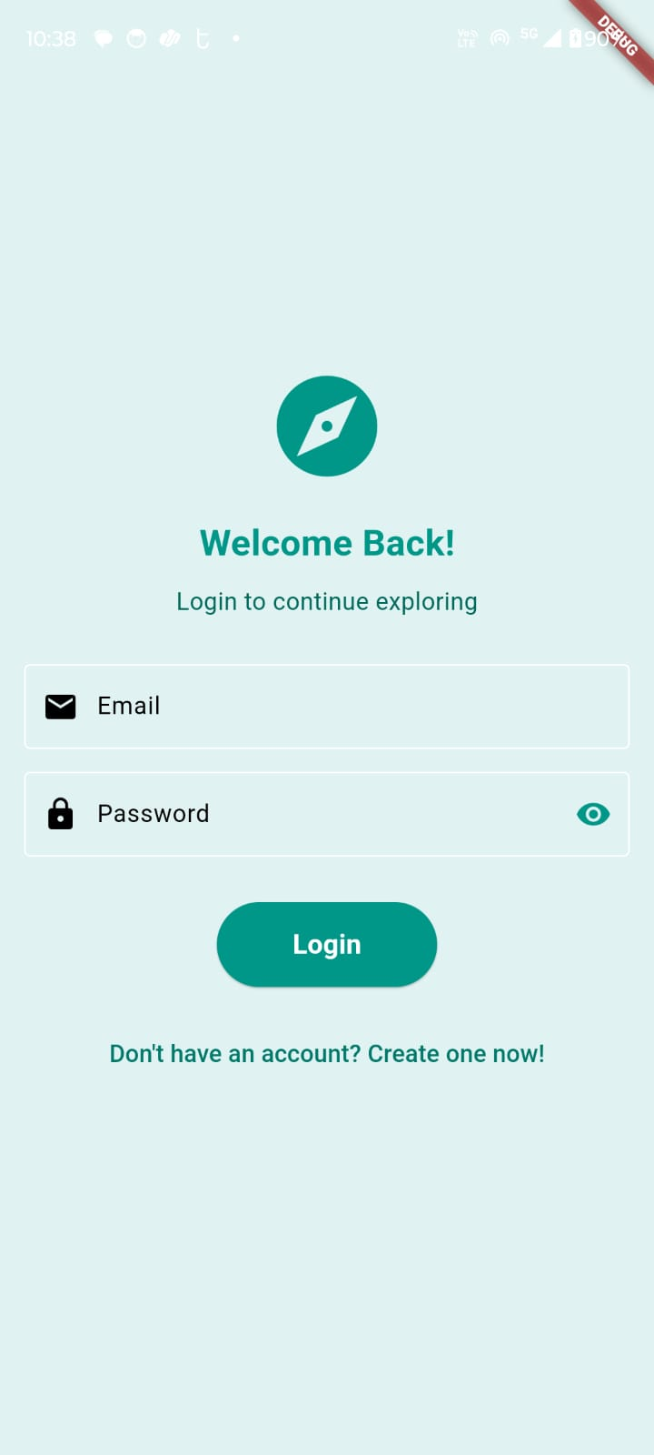
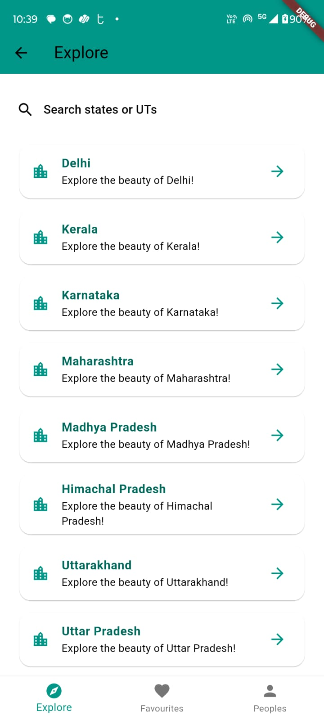

Slide 12
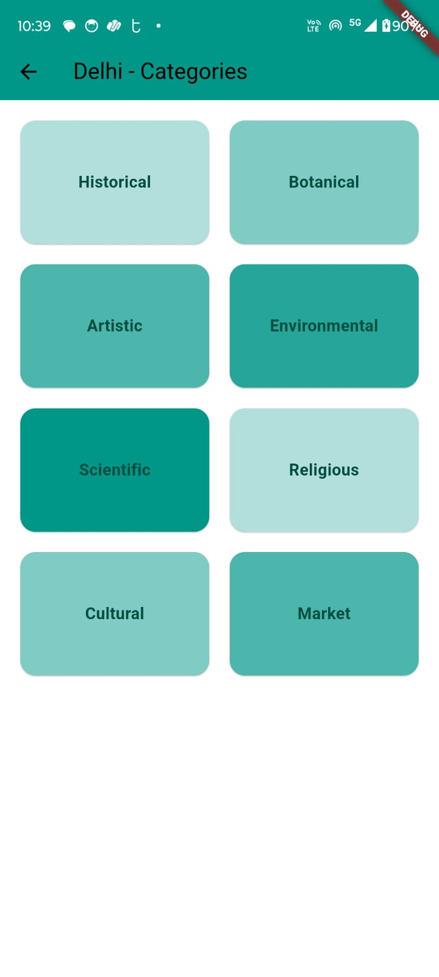
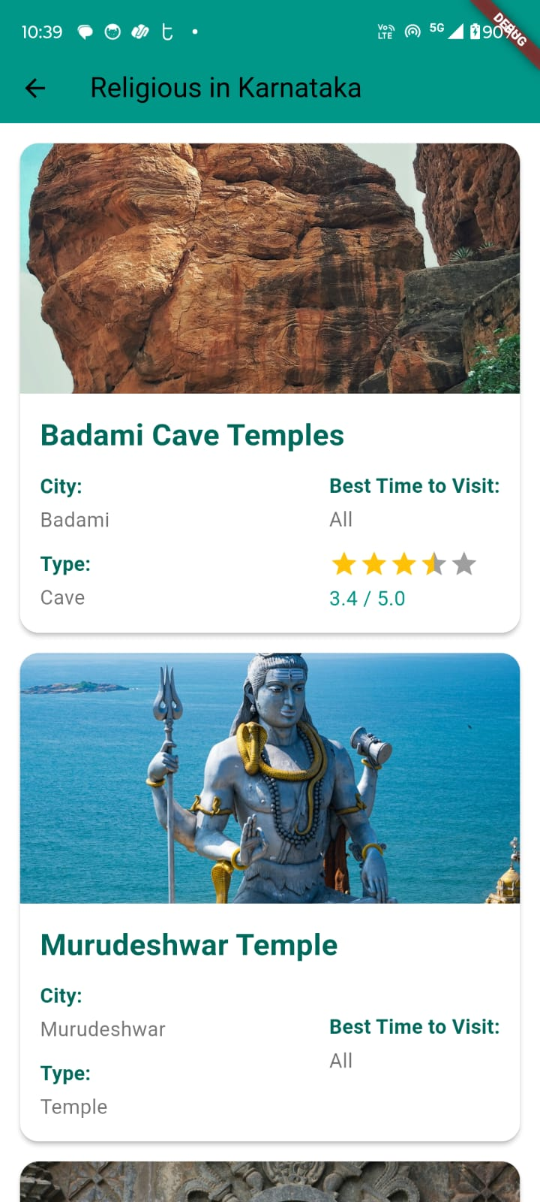
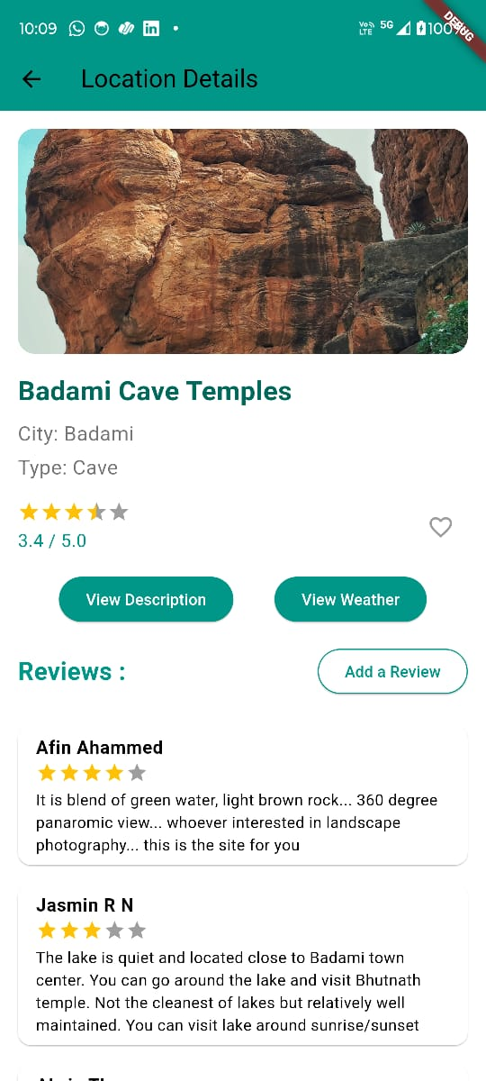

Slide 13
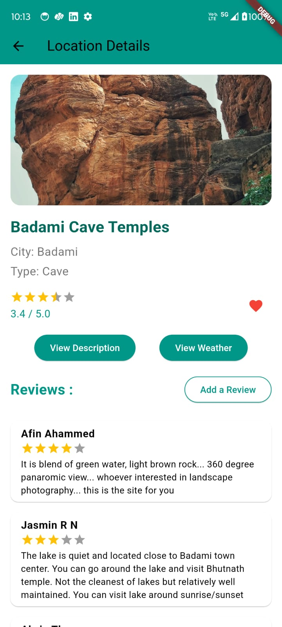
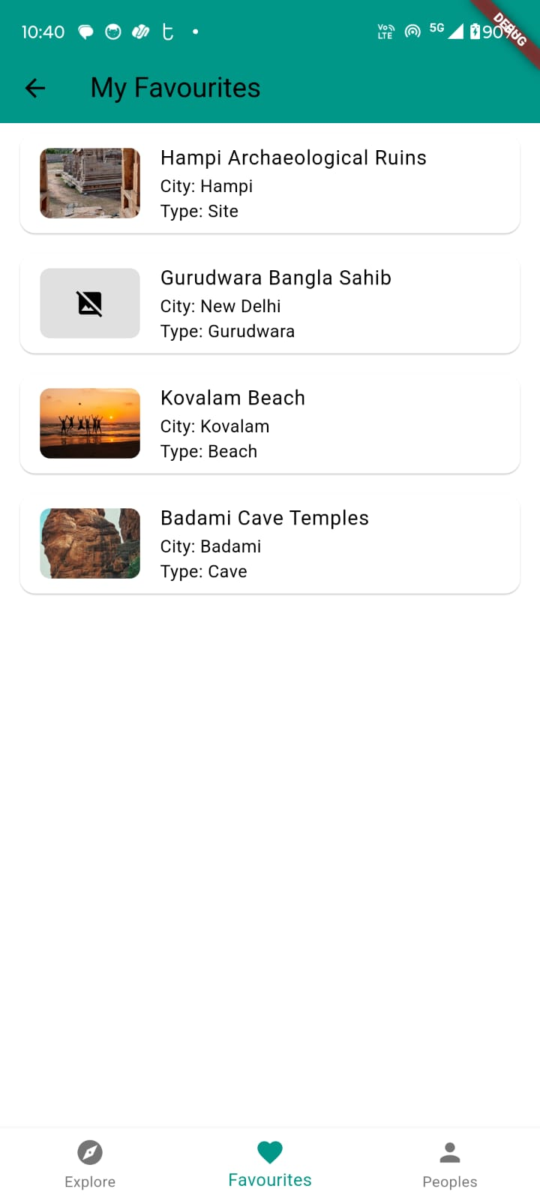

Slide 14
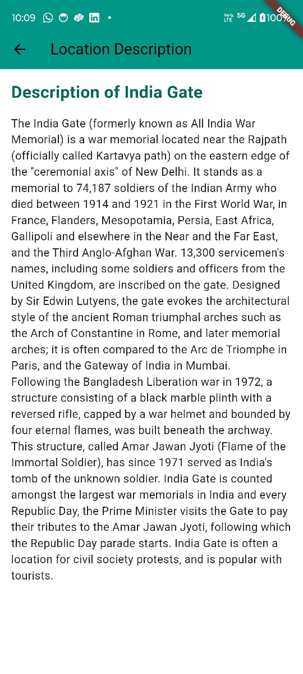
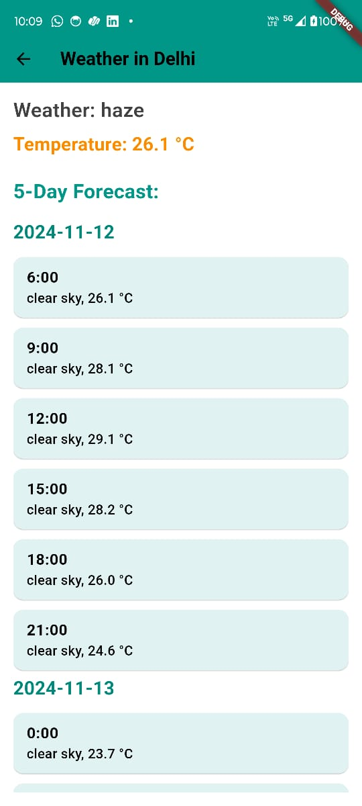
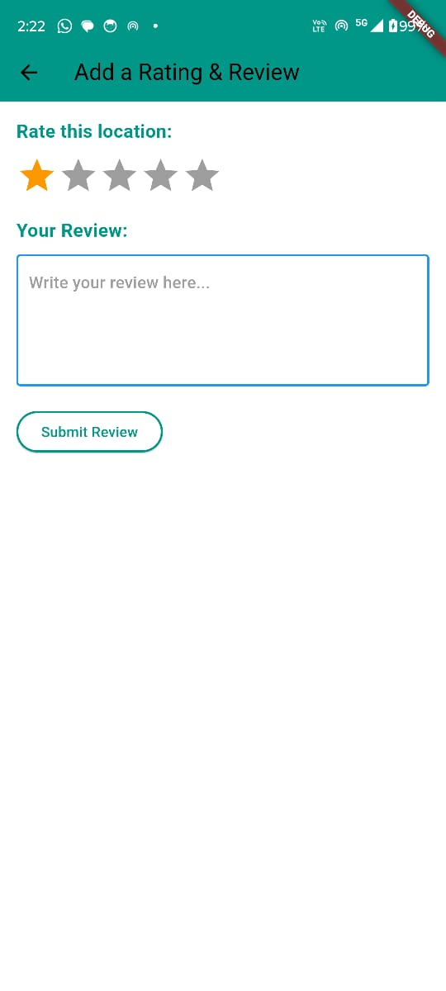

Slide 15
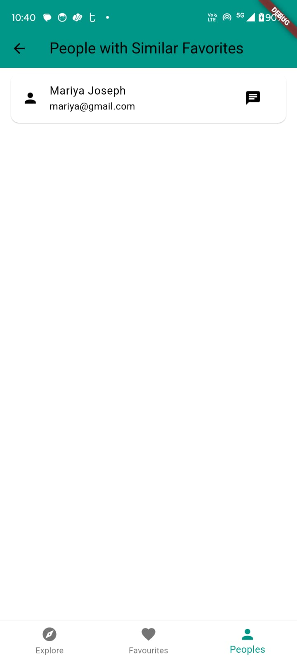
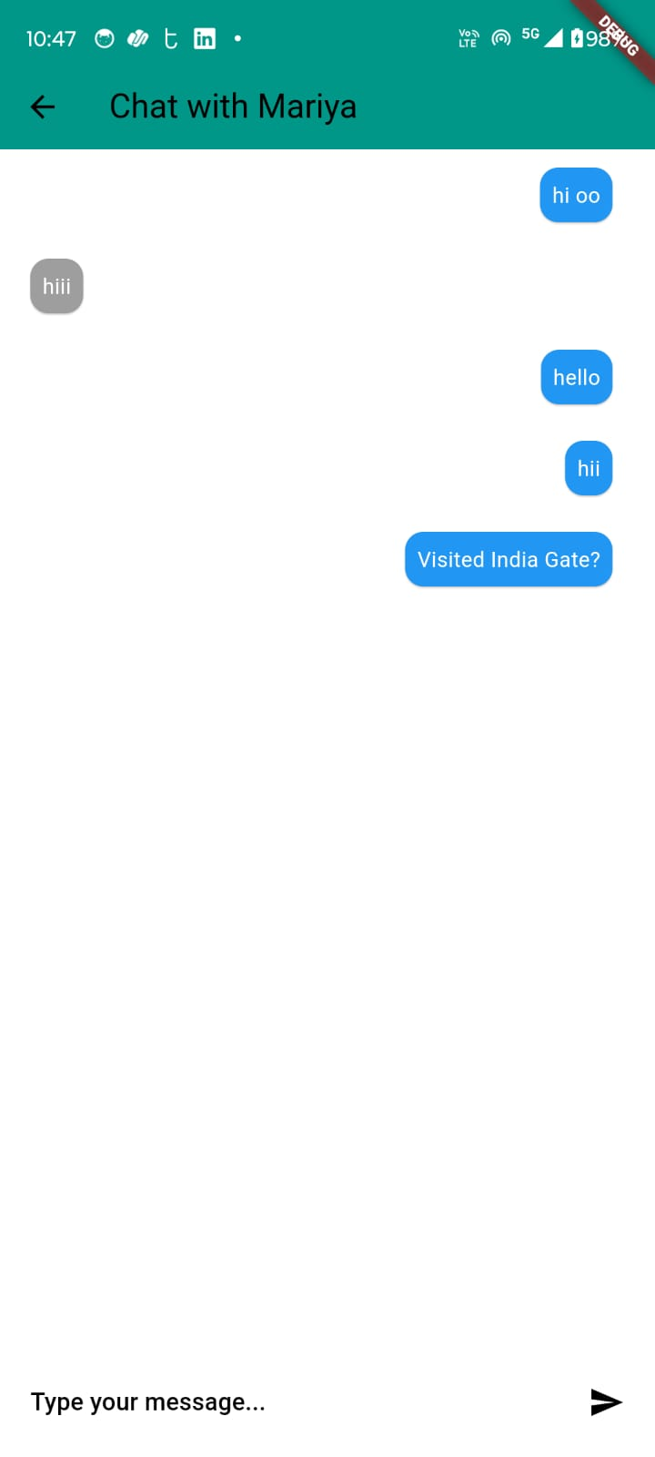

Slide 16

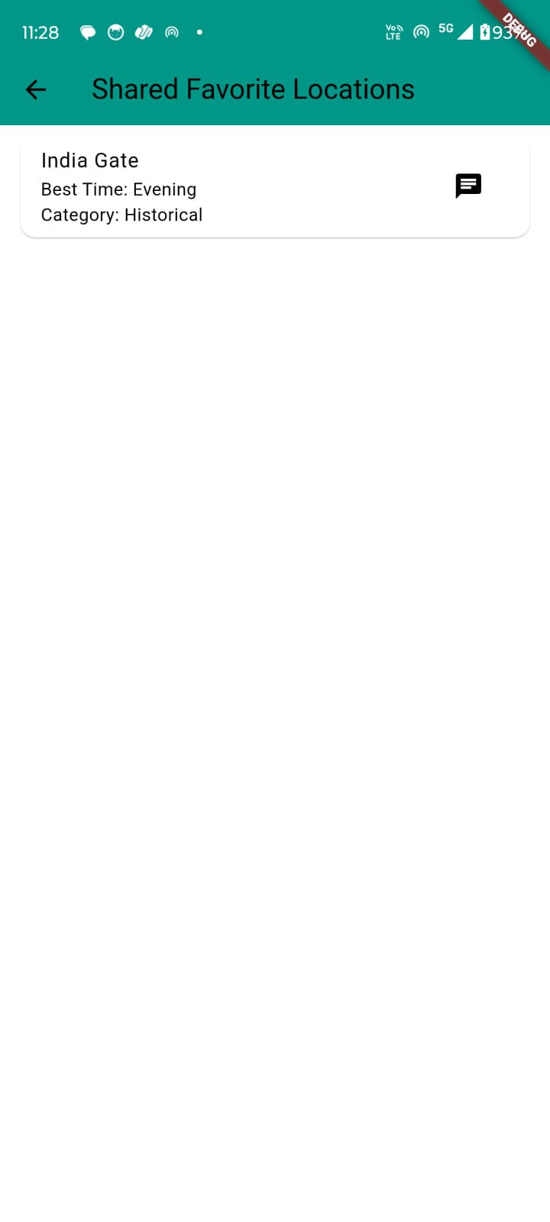
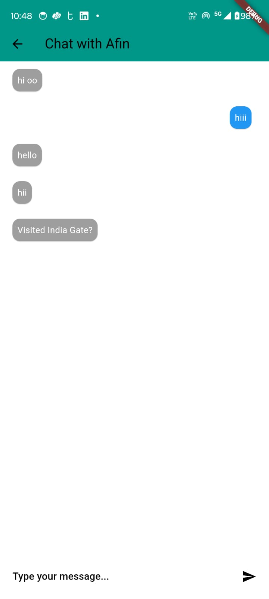

Slide 17
THANK YOU
11

